Slide 1
The Construction and Uses of Heffter Arrays
Jeff Dinitz
University of Vermont
and Dan Archdeacon, Tom Boothby, Diane Donovan, Amelia Mattern, Sule Yazici, Doug Stinson, Ian Wanless

Slide 2
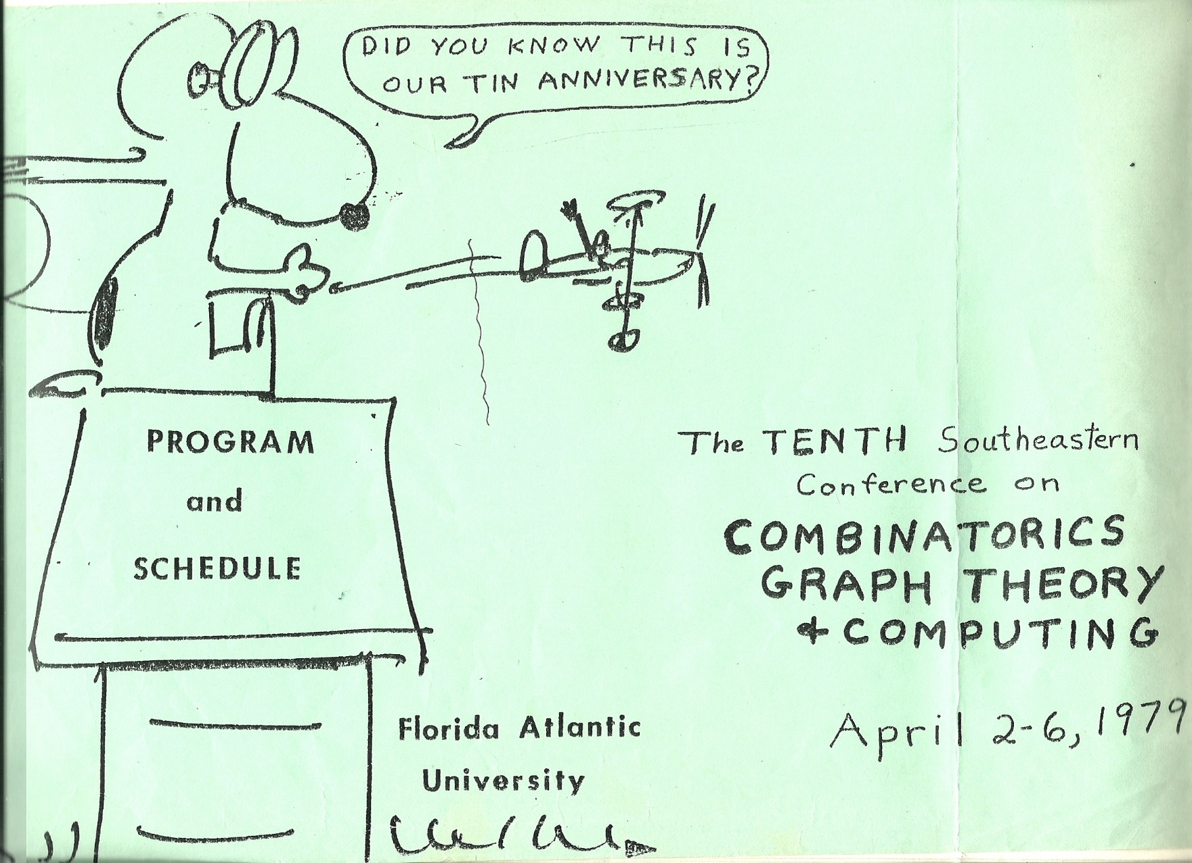
My first time at this conference
Notes:
met Spyros, Earl, Dale, Charlie, Rosa, Mullin, Herb Taylor

Slide 3
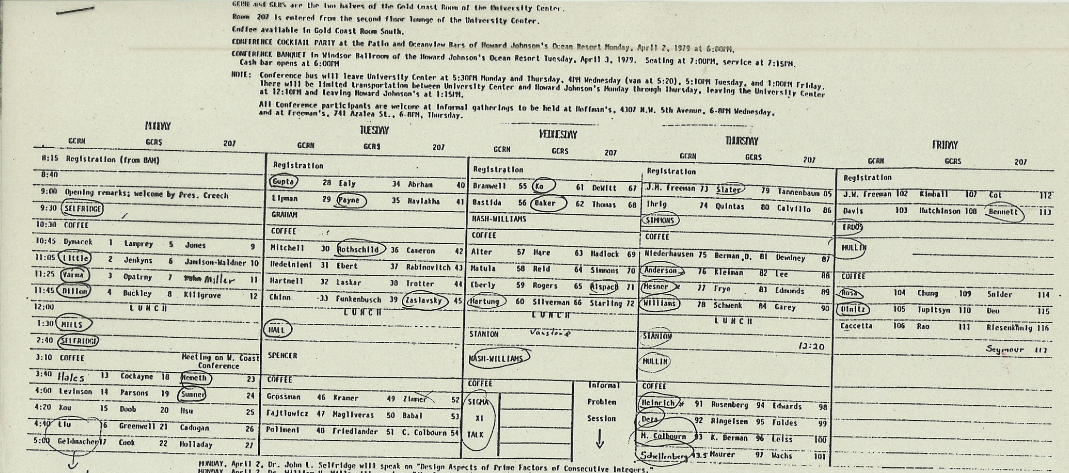
The schedule from 1979
Invited Speakers: John Selfridge, Bill Mills, Ron Graham, Marshall Hall, Joel Spencer, Crispin Nash-Williams, Ralph Stanton, Gus Simmons, Ron Mullin, and Paul Erdos (117 talks total)

Slide 4
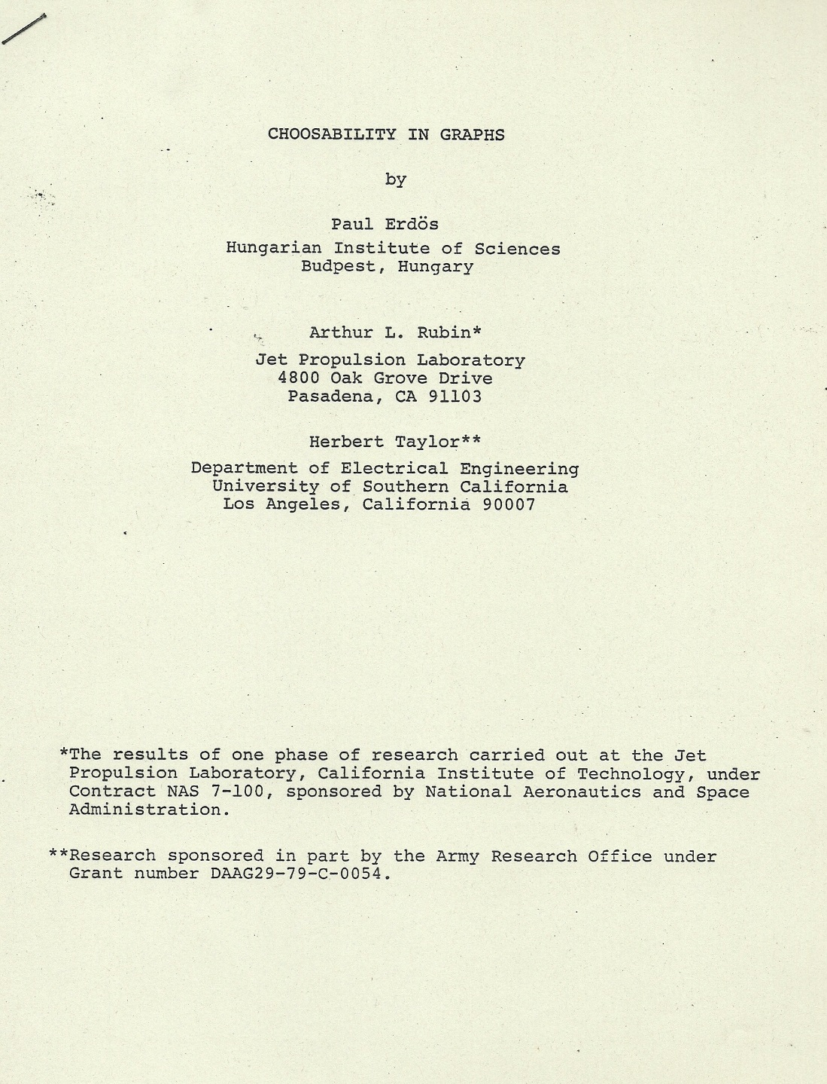

Slide 5
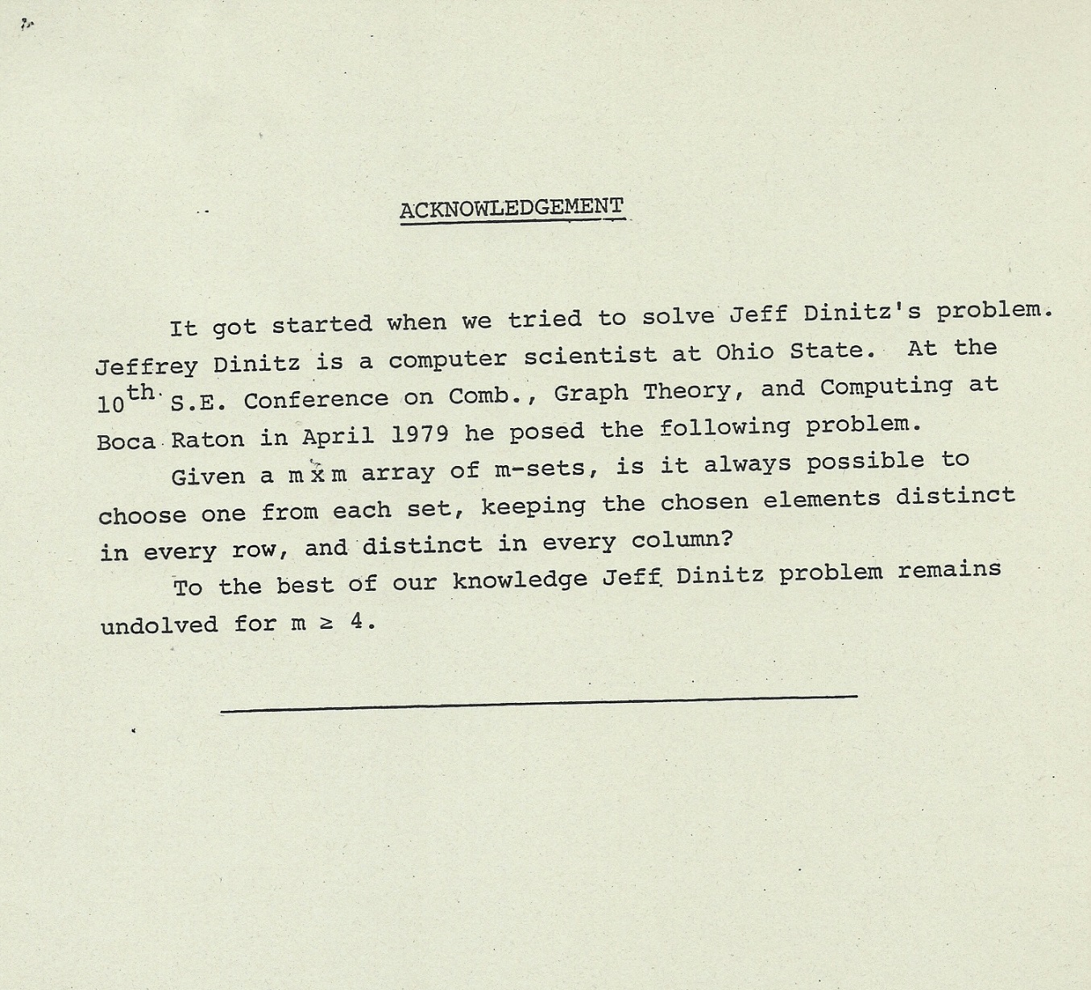

Slide 6
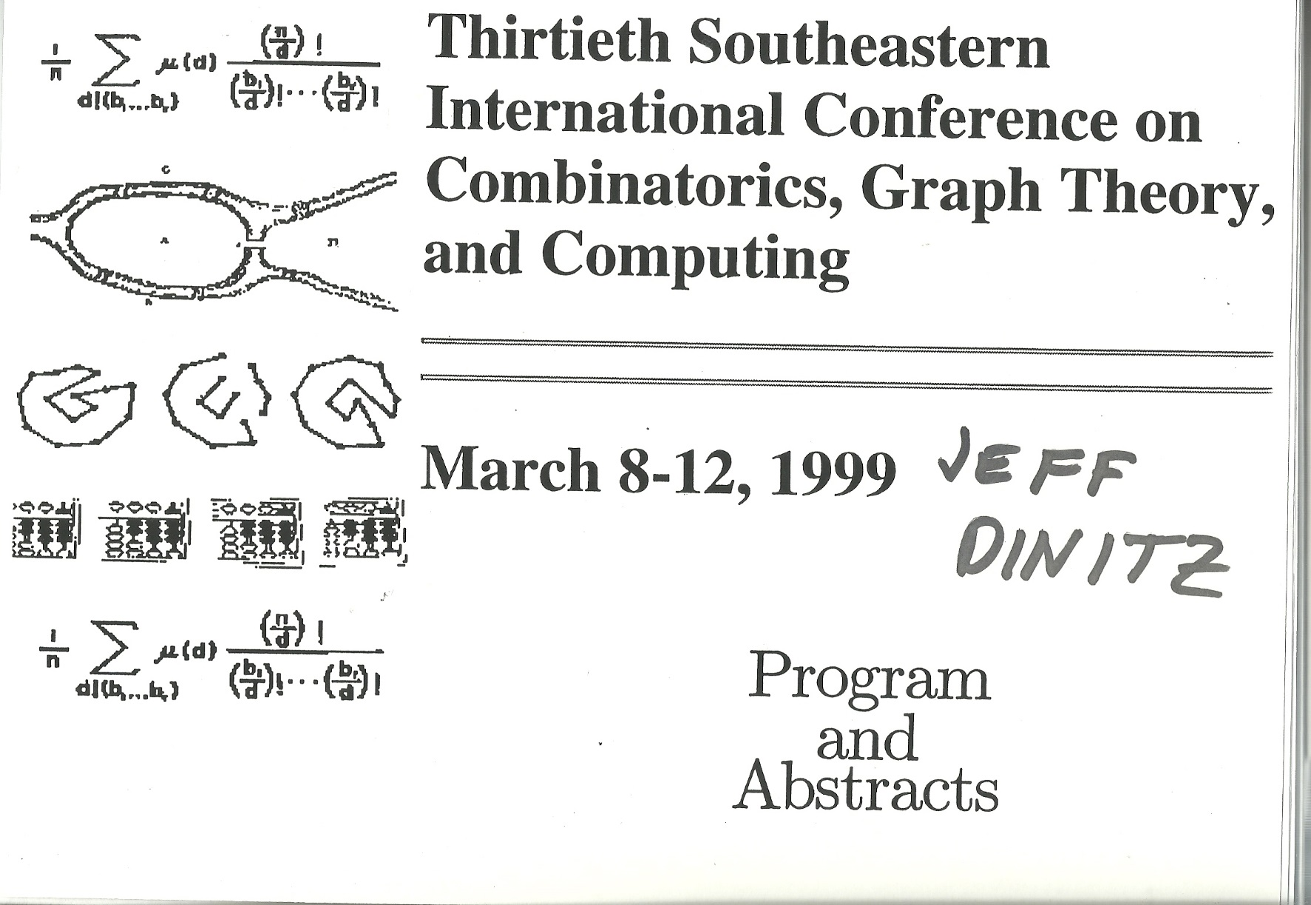
Invited speakers: Martin Aigner, Laci Babai, David Bressoud, Brendan McKay, Andrew Odlyzko, Ann Trenk, Scott Vanstone, J.D. (I spoke on bicoloring designs). (224 total talks)

Slide 7
It begins in 2013
Jeff, we are going to have lots of fun with this. It has to do with topological embeddings and putting numbers in boxes
Dan Archdeacon

Slide 8
Topological Embeddings
A biembedding of the complete graph K_{m} is an embedding that is face 2-colorable.
We are particularly interested when the face boundaries of the first color class form an s-cycle system and those of the other color class form a t-cycle system.
These have most commonly been studied in the case
s = t = 3, i.e., both color classes are STS(m)'s.

Slide 9
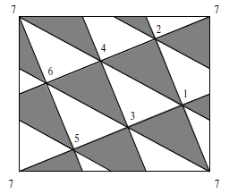
A well known example
This is K₇ embedded on the torus.
Here we decompose K₇ into two sets of 3-cycles (black and white) and each edge borders exactly one black and one white triangle.

Slide 10
Each face is a triangle and there are 14 faces.
There are 7 vertices and edges so
v – e + f = 7 – 21 + 14 = 0
So 0 = 2 – (2 x g) (where g is the genus of the surface).
So the genus is 1 and thus we see (again) that this embedding is on the torus.

Slide 11
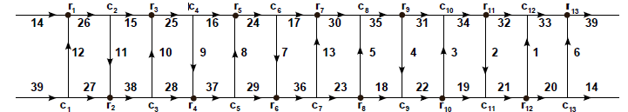
What’s known about biembedding cycle systems on orientable surfaces.
In 1890, Heffter was the first to do “topological design theory”, He showed that if 4s+3 is prime and the order of 2 modulo 4s+3 is either 4s+2 or 2s+1, then one can construct a twofold triple system of order 12s+7, the blocks of which are the triangular faces of an embedding of the complete graph K_{12s+7} in an orientable surface. [Still unknown if there are infinitely many such s.]
Numerical considerations imply that orientable biembeddings of two STS(n) can only exist if n ≡ 3 or 7 mod 12.
In 1970, Youngs showed that if n ≡ 7 mod 12, there exists a biembedding of two cyclic STS(n) in an orientable surface. He find a bipartite current graph (a ladder graph) and shows that this lifts to a triangular biembedding.

Slide 12
What’s known about biembedding cycle systems on orientable surfaces.
In 1890, Heffter was the first to do “topological design theory”, He showed that if 4s+3 is prime and the order of 2 modulo 4s+3 is either 4s+2 or 2s+1, then one can construct a twofold triple system of order 12s+7, the blocks of which are the triangular faces of an embedding of the complete graph K_{12s+7} in an orientable surface. [Still unknown if there are infinitely many such s.]
Numerical considerations imply that orientable biembeddings of two STS(n) can only exist if n ≡ 3 or 7 mod 12.
In 1970, Youngs showed that if n ≡ 7 mod 12, there exists a biembedding of two cyclic STS(n) in an orientable surface. He finds a bipartite current graph (a ladder graph) and shows that this lifts to a triangular biembedding.
Ringle’s 1974 book “Map Color Theorem” gives bipartite current graphs for n ≡ 3 mod 12 and hence shows that if n ≡ 3 mod 12, there exists a biembedding of two cyclic STS(n) in an orientable surface.

Slide 13
What’s known about biembedding cycle systems on orientable surfaces.
There are exactly 2408 cyclic biembeddings of STS in an orientable surface on 31 points. (Bennett et. al. 2001)
All 80 STS(15) can be biembedded in an orientable surface with another STS(15) (78 have self-embeddings). (Grannell et.al. 2009)
There exists a biembedding of an STS(n) and a Hamilton decomposition of K_{n} for all n ≡ 3 mod 36. (McCourt, 2014)
There exists a biembedding of two n-cycle systems on 2n+1 points iff n is odd (and n ≥ 3). (Griggs, McCourt 2016)

Slide 14
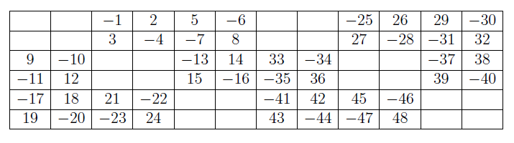
A Heffter array
An H(6,12;8,4)

Slide 15
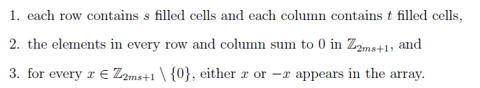
The General Definition
A Heffter array H(m,n;s,t) is an m x n matrix with nonzero entries from ℤ_{2ms+1} such that :
If s = n we denote it as H(m,n) and call it a tight Heffter array (all cells are filled).
If m = n we denote it by H(m;t) (it is a square array with empty cells).
If the elements in each row and column sum to 0 in ℤ , it is called an integer Heffter array.

Slide 16
Some Examples
An H(6,12;8,4) again

Slide 17

Tight Heffter arrays
1 | -2 | 3 | -4 | 11 | -9
-7 | 8 | -12 | 10 | -5 | 6
-13 | 14 | -15 | 16 | -23 | 21
19 | -20 | 24 | -22 | 17 | -18
H(3,4)
H(4,6)
7 | 12 | 18 | 6 | 3 | -5 | -13 | -27 | -1
10 | 9 | -14 | -26 | 22 | 16 | -2 | 8 | -23
-17 | -21 | -4 | 20 | -25 | -11 | 15 | 19 | 24
H(3,9)

Slide 18
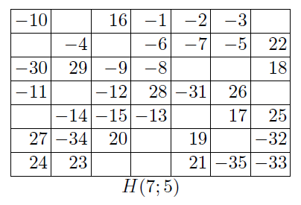
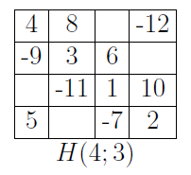
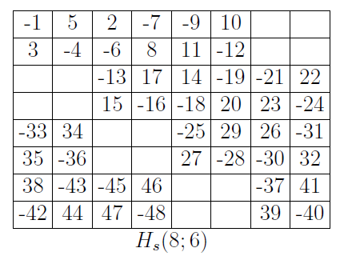
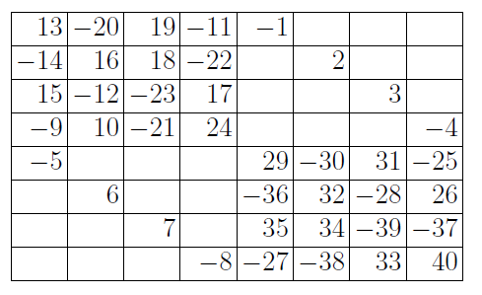
Square Heffter arrays with empty cells
H(8;5)

Slide 19
Main theorem connecting Heffter arrays and biembeddings
Theorem (Archdeacon 2014): Given a Heffter array H = H(m,n;s,t) with compatible simple orderings ω_{r} on the rows and ω_{c} on the columns of H, there exists an orientable embedding of K_{2ms + 1} such that every edge is on a face of size s and a face of size t, i.e. a biembedding of a s-cycle system and a t-cycle system.

Slide 20
How to make the embedding
by example
H(3,4)=
Starting with an H(3,4)
We will embed K₂₅ (25 = 2 x 3 x 4 + 1) on a surface such that each face is either a triangle or a 4-cycle and each edge borders exactly one triangle and one 4-cycle.
First generate the 3-cycles by developing the columns in Z₂₅
From first column we get the 3-cycles
(0,1,8)
(1,2,9)
(2,3,10)
…
(24,0,7)
The second column gives the 3-cycles
(0,23,19), (1,24,20)
(2,0,21)
…
(24,22,18)
The third column gives the 3-cycles
(0,11,20), (1,12,21)
(2,13,22)
…
(24,10,19)
The fourth column gives the 3-cycles
(0,15,3), (1,12,21)
(2,13,22)
…
(24,14,2)

Slide 21
Note that this is a “difference construction” and hence since each difference from Z₂₅ is used exactly once, we have developed all of the edges of K₂₅ and each edge is in exactly one 3-cycle. So the columns generate a cyclic 3-cycle system (a cyclic Steiner triple system).
Now do the same with the rows to get all the 4-cycles.
Note that each edge is on exactly one 4-cycle, too.
The first row generates the 4-cycles
(0,1,24,10)
(1,2, 0, 11)
(2,3, 1, 12)
…
(24,0,23,9)
The second row generates the 4-cycles
(0,7,3,12)
(1,8,4,13)
(2,9,5,14)
…
(24,6,2,11)
The third row generates the 4-cycles
(0,17,23,3)
(1,18,24,4)
(2,19,25,5)
…
(24,16,22,2)
Similar to how the columns generate a cyclic 3-cycle system, we see that the rows generate a cyclic 4-cycle system.
From the construction, we have that a pair of edges that are in a triangle together
in the 3-cycle system are not in a 4-cycle together and vice versa.

Slide 22
Main theorem connecting Heffter arrays and biembeddings
Theorem (Archdeacon 2014) Given a Heffter array H = H(m,n;s,t) with compatible simple orderings ω_{r} on the rows and ω_{c} on the columns of H, there exists an orientable embedding of K_{2ms + 1}
such that every edge is on a face of size s and a face of size t.
H(3,4) =
The row permutation ω_{r} is simple if
the partial sums of each row are all distinct (modulo 2ms+1).
In this example,
    the partial sums of row 1 are 1,-1,10, 0
    the partial sums of row 2 are 7,3,12, 0
    the partial sums of row 3 are -8,-2, 3, 0
ω_{c} is simple if the partial sums of each column are all distinct (modulo 2ms+1).

Slide 23
Main theorem connecting Heffter arrays and biembeddings
Theorem (Archdeacon 2014) Given a Heffter array H = H(m,n;s,t) with compatible simple orderings ω_{r} on the rows and ω_{c} on the columns of H, there exists an orientable embedding of K_{2ms + 1}
such that every edge is on a face of size s and a face of size t.
H(3,4) =
For this example we use the natural ordering to create row and column permutations:
ω_{r}= (1 -2 11 -10) (7 -4 9 -12) (-8 6 5 -3) (the row permutation)
and
ω_{c} = (1 7 -8) (-2 -4 6) (11 9 5) (-10 -12 -3) (the column permutation)
But we could change the direction in any of these cycles to create a different ordering.

Slide 24
Main theorem connecting Heffter arrays and biembeddings
Theorem (Archdeacon 2014) Given a Heffter array H = H(m,n;s,t) with compatible simple orderings ω_{r} on the rows and ω_{c} on the columns of H, there exists an orientable embedding of K_{2ms + 1}
such that every edge is on a face of size s and a face of size t.
H(3,4) =
We say that ω_{r} and ω_{c} are compatible if the
permutation ω_{r} о ω_{c} is a single cyclic permutation.
Here ω_{r} о ω_{c} = (1 -4 5 -10 7 6 11 -12 -8 -2 9 -3) a single permutation of length 12.

Slide 25
Main theorem connecting Heffter arrays and biembeddings
Basically the row and columns are developed modulo 2ms+1 to become the faces of the embedding.
Simple ensures that they are full s-cycles and t-cycles
The composition of the row and column orderings gives the ordering of the faces around each vertex. Compatibility ensures there are no “pinch points”.

Slide 26
To summarize:
If there exists a Heffter array H = H(m,n;s,t), and the rows and columns can be ordered so that all the partial sums are distinct, then there exists a cyclic s-cycle system S and a cyclic t-cycle system T, both on 2ms+1 points.
Furthermore, if the row and column rotations are compatible, then two systems can be embedded on an orientable surface such that each edge borders exactly one s-cycle and one t-cycle (a biembedding).

Slide 27
Now – let’s make some Heffter arrays ☺

Slide 28
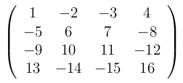
Necessary conditions for the existence of an H(m,n; s,t) (especially for integer sums)
The number of filled cells in each row and column must be ≥ 3 (or else you get either 0 or both x, –x in the array).
Lemma: If an integer Heffter array H(m,n; s,t) exists, then
m x s ≡ 0,3 (mod 4)
Proof: Note that m x s is the total number of symbols in the array. Reduce the entries in the array modulo 2. Each row and column sums to 0 so it contains an even number of odd numbers. Hence the number of odds from 1,…,ms must be even, giving the parity condition.
An H(4,4)

Slide 29
Results on tight Heffter arrays H(m,n)
Archdeacon, Boothby, Dinitz, (J. Combin. Des. 2017)
Theorem 1: There is an m x n tight integer Heffter array if and only if m,n ≥ 3 and m x n ≡ 0,3 mod 4.
Theorem 2: There is an m x n tight Heffter array modulo 2mn+1 for all m, n ≥ 3.

Slide 30
The easy case: m,n ≡ 0 (mod 4)
Consider the 4 x 4 square A shown on the right with { |a_{i,j} | } = 1,…,16
Add 16 to the magnitude of each entry, i.e., b_{i,j} = a_{i,j} + 16 if a_{i,j} is positive,
b_{i,j} = a_{i,j} – 16 if a_{i,j} is negative.
Call the new array B = A ± 16
Since there are the same number of positive and negative entries in each row and column, the result B has row and columns sums equal to 0 and has entries ±17,…,32 .
Define a shiftable Heffter array if all rows and columns have the same number of positive and negative entries. The H(4,4) shown is shiftable.

Slide 31
Fitting 4 x 4’s to make an H(m,n)
Let’s make an H(8,12).
Start with the shiftable H(4,4), A =
Now make the 8 x 12 array:
or
A | A ± 16 | A ± 32
A ± 48 | A ± 64 | A ± 80
1 | -2 | -3 | 4
-5 | 6 | 7 | -8
-9 | 10 | 11 | -12
13 | -14 | -15 | 16
17 | -18 | -19 | 20
-21 | 22 | 23 | -24
-25 | 26 | 27 | -28
29 | -30 | -31 | 32
33 | -34 | -35 | 36
-37 | 38 | 39 | -40
-42 | 42 | 43 | -44
45 | -46 | -47 | 48
Note that the table entries are 1 – 96 (in absolute value) and each row and column adds to 0.
Hence it is an integer H(8,12)
49 | -50 | -51 | 52
-53 | 54 | 55 | -56
-57 | 58 | 59 | -60
61 | -62 | -63 | 64
65 | -66 | -67 | 68
-69 | 70 | 71 | -72
-73 | 74 | 75 | -76
77 | -78 | -79 | 80
81 | -82 | -83 | 84
-85 | 86 | 87 | -88
-89 | 90 | 91 | -92
93 | -94 | -95 | 96

Slide 32
Next easiest: m ≡ 0 mod 4, n ≡ 2 mod 4
The proof is similar. The array below is a shiftable 4 x 6 Heffter array.
We can piece together shifts of this 4 x 6 array and 4 x 4 arrays to cover these congruence classes.
1 | -2 | 3 | -4 | 11 | -9
-7 | 8 | -12 | 10 | -5 | 6
-13 | 14 | -15 | 16 | -23 | 21
19 | -20 | 24 | -22 | 17 | -18

Slide 33
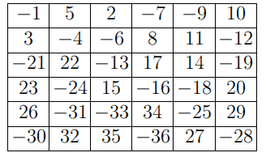
Finally m,n ≡ 2 mod 4
Same as other two cases:
Start with a shiftable H(6,6) in upper left corner and then add as many shiftable H(4,4) as necessary to get the desired size.
An H(18,14)
6 4 4
A | 6 x 4 shiftable | 6 x 4 shiftable
4 x 6 shiftable | 4 x 4 shiftable | 4 x 4 shiftable
4 x 6 shiftable | 4 x 4 shiftable | 4 x 4 shiftable
4 x 6 shiftable | 4 x 4 shiftable | 4 x 4 shiftable
6
4
4
4

Slide 34
So we have constructed a tight integer Heffter array H(m,n) for all even values of m,n ≥ 4.
Next we tackle ones with odd side.

Slide 35
3 x n Heffter arrays
Possible over the integers if n ≡ 0,1 mod 4.
Over the integers modulo 6n+1, otherwise.
6n+1 sure looks familiar (think STS) – this is where the term Heffter arrays came from. It relates to Heffter’s first difference problem from 1897.

Slide 36
Heffter’s first difference problem
Can the set {1,2,…3n} be partitioned into n triples {a,b,c} such that
a + b = c
or a + b +c ≡ 0 (mod 6n+1) ?
The answer is yes for all n ≥ 1. Proved by Peltesohn (1939). Closely related to Skolem sequences.
A solution to Heffter’s first difference problem can be used to form a cyclic Steiner triple system (STS) of order 6n+1.

Slide 37
So a Heffer array H(3,n) is an arrangement of the triples solving Heffters first difference problem (on the set {±1, ±2,… ±3n}) into a 3 x n array such that the triples are in the columns and each row sum is 0 (mod 6t+1).
Wow!
Below is an integer H(3,9)
Note that a column containing a,b and c has a + b = -c or a + b = c
So they can be used to construct a cyclic STS(55) .
The rows add to 0, so they can be developed modulo 55 to construct a cyclic 9-cycle system on 55 points.
7 | 12 | 18 | 6 | 3 | -5 | -13 | -27 | -1
10 | 9 | -14 | -26 | 22 | 16 | -2 | 8 | -23
-17 | -21 | -4 | 20 | -25 | -11 | 15 | 19 | 24

Slide 38
Construction method
Use solutions to Heffter’s difference problem (coming from Skolem sequences) and do a computer search (using exact covering) to sort out an appropriate row pattern.
Based on the different congruence classes modulo 8, general solutions are found.

Slide 39
Sample code for finding H(3,t), t ≡ 5 mod 8
(* The case t = 8m + 5, any nonnegative m *)
heffter5[m_] := Module[{partial} (* the local variables *),
(* start with the sporadic blocks *)
partial :=
{{8*m + 6, -16*m - 9, 8*m + 3},
{10*m + 7, 8*m + 5, -18*m - 12},
{-16*m - 10, 4*m + 2, 12*m + 8},
{-4*m - 4, -18*m - 11, 22*m + 15},
{4*m + 1, 18*m + 13, -22*m - 14}};
(* and add in the 4 infinite classes *)
Do[partial = Join[partial,
{{-(8*m - 2*r + 1)*(-1)^r , (16*m - r + 8)*(-1)^r, -(8*m + r + 7)*(-1)^r}},
{{-(14*m - r + 8)*(-1)^r, 2*(2*m - r)*(-1)^r , (10*m + r + 8)*(-1)^r}},
{{(16*m + r + 11)*(-1)^r, 2*(4*m - r + 2)*(-1)^r, -(24*m - r + 15)*(-1)^r}},
{{(4*m - 2*r - 1)*(-1)^r , (18*m + r + 14)*(-1)^r, -(22*m - r + 13)*(-1)^r}}]
, {r, 0, 2 m - 1}];
partial ] (* end \
module *)

Slide 40
Just showing off
This is an H(3,50) -- check it ☺

Slide 41
So we have
Theorem: Heffter arrays H(3,n) exist for all n ≥ 3.

Slide 42
Can get all H(m,n) with m ≡ 3 and n ≡ 0 mod 4
Similar method as before. Place an integer H(3,n) on top and fill in with shiftable H(4,4).
Example: An H(11,12)
H(3,12)
H(4,4) shiftable | H(4,4) shiftable | H(4,4) shiftable
H(4,4) shiftable | H(4,4) shiftable | H(4,4) shiftable
3
4
4
4 4 4

Slide 43
The 5 x n case
Theorem: There exist 5 x n Heffter arrays for all n ≥ 3.
Proof: An 8-part difference construction depending on n mod 8 with some small sporadics. Used a Skolem sequence as a starting point, then did some searching on the computer.

Slide 44
H(m,n) with m ≡ 1 and n ≡ 0 mod 4
Theorem: There exist an integer Heffter array H(m,n) for all m ≡ 1, n ≡ 0 mod 4.
Proof: Again place the H(5,n) on top and fill in with shiftable H(4,4). Use induction on n in steps of size 4 by adding shiftable 4 x 4 arrays.

Slide 45
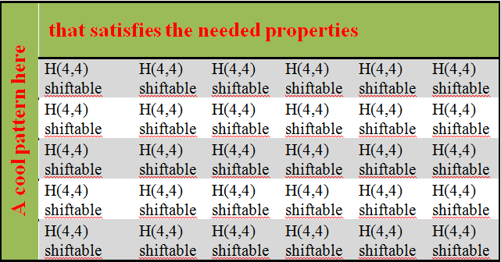
Last case for integer Heffter arrays: m ≡ 1 mod 4, n ≡ 3 mod 4
Use an “ell” construction with a border of 5 rows and 3 columns and fill in with shiftable H(4,4).
3
5

Slide 46
The non-integer (modular) congruence classes
The remaining congruence classes can not have all rows and columns adding to 0, some must add to 0 mod 2mn+1
These cases are:
  m ≡ n ≡ 1 mod 4, 9 rows and 9 col. border with shiftable H(4,4)
  m ≡ 1, n ≡ 2 mod 4 H(9,n) above shiftable H(4,6) and H(4,4)
  m ≡ 3, n ≡ 2 mod 4 H(7,n) above shiftable H(4,6) and H(4,4)
  m ≡ 3, n ≡ 3 mod 4 7 rows and 7 col. border with shiftable H(4,4)

Slide 47
A computer program
Tom Boothby wrote a program in python which finds tight H(m,n) for all m,n ≥ 3.
A demo:

Slide 48
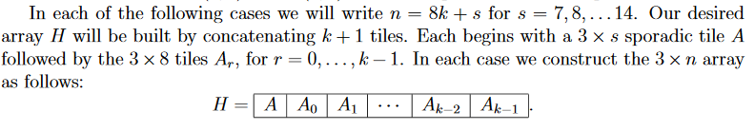
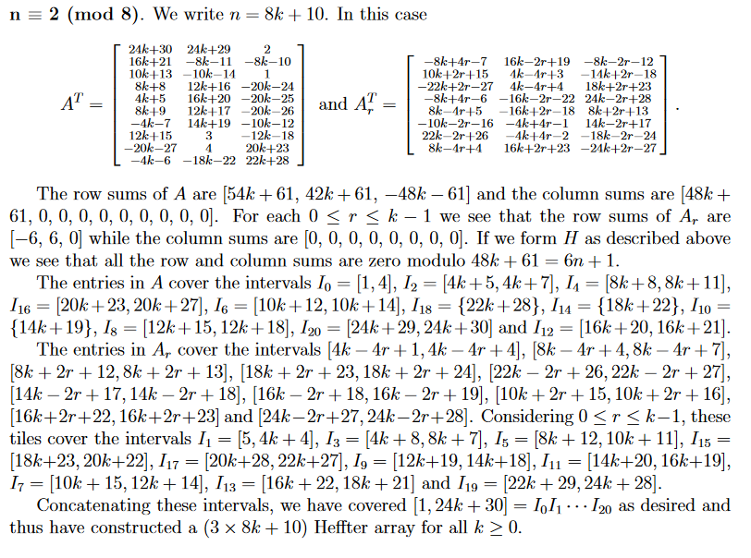
We used Sage to check and write the text for the proofs

Slide 49
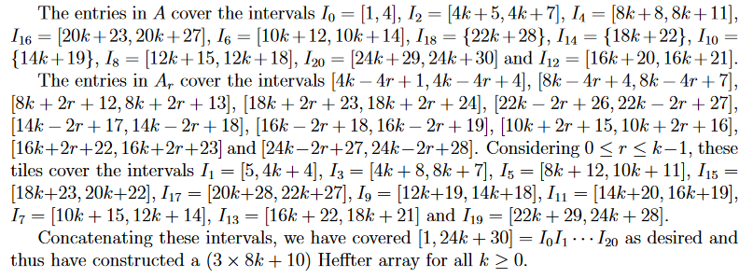

Slide 50
The Theorems:
Theorem 1: There is a tight integer Heffter array H(m,n) whenever m,n ≥ 3 and m x n ≡ 0,3 mod 4
Theorem 2: There is a tight Heffter array H(m,n) modulo 2mn+1 for all m,n ≥ 3.

Slide 51
So now let’s biembed some cycle systems

Slide 52
Biembedding Steiner triple systems and n-cycle systems
Dinitz and Mattern (Austral. J. of Comb., 2017 )
First we proved a simplified version of Archdeacon’s theorem.
Theorem: Given a simple Heffter array H= H(m,n) where at least one of m or n is odd, there exists a biembedding on an orientable surface of a m-cycle system and an n-cycle system both on the same v = 2nm+1 points.
We started with the H(3,n) from the first paper and reordered the rows so that we had a simple H(3,n). The rows and columns are compatible as permutations (since 3 is odd).
The following gives an example of what we did.

Slide 53
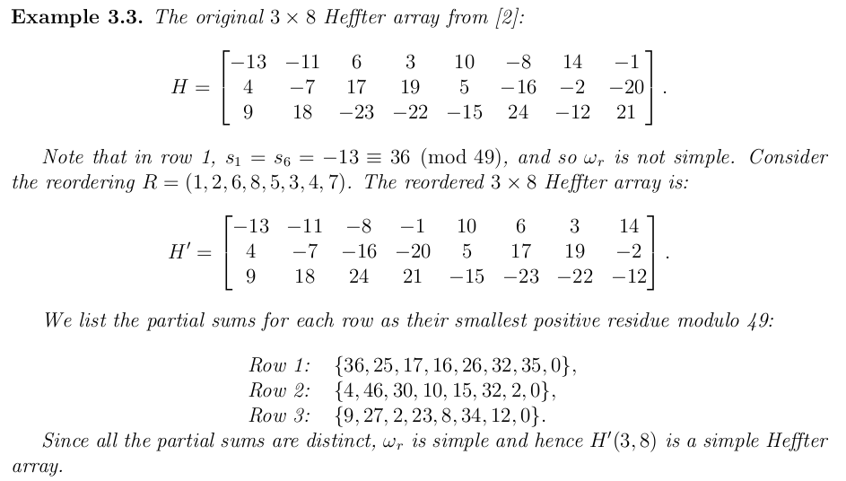
An Example

Slide 54
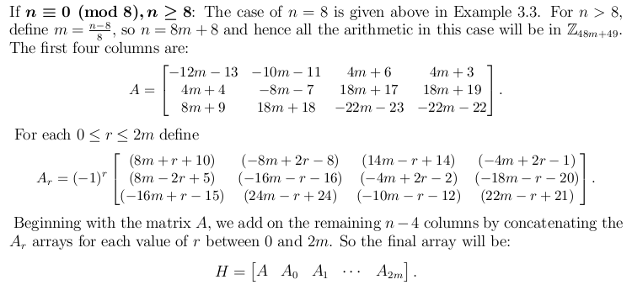
Biembedding Steiner triple systems and n-cycle systems
We did this for each of the cases of n modulo 8
Here is one of the cases:
The reordering of the rows is
R = (9,13,...,n-3;1,11,15,..,n-1;2,10,14,..,n-2;6,8,12,16,..., n,5,3,7,4)

Slide 55
Main biembedding theorem
Theorem: For every n ≥ 3, there exists an orientable biembedding of K_{6n+1} such that every edge is on a 3-cycle and a simple n-cycle.
or equivalently,
For every n ≥ 3, there exists an orientable biembedding of a Steiner triple system and a simple n-cycle system, both on 6n+1 points. Furthermore, each of the two cycle systems is cyclic modulo 6n+1.

Slide 56
A short diversion to simple orderings
So – we would love to be able to order each row of a Heffter array so that the partial sums are all distinct.
This is an interesting problem in it’s own right.
It was a cold and snowless winter in 2015 …
So I took a road trip to Waterloo to visit President Doug.

Slide 57



Beer tasting, wine tasting, Scotch tasting – nice trip!
Now let’s order some subsets of groups ☺

Slide 58

Simple orderings of permutations
Let A Z_{n} \ {0} and let be an ordering of the elements in A.
Let be the i^{th} partial sum.
The ordering is simple if for i ≠ j .
Note that this is equivalent to saying that no “run”
r_{i,j} is equal to 0, where
$$⊆$$

Slide 59
Example: n = 10, k = 6, A = {1,2,4,6,7,8}.
Note that (1,2,4,6,7,8) is not a simple ordering of A,
but (1,2,4,7,6,8) has partial sums (1,3,7,4,0,8) and hence A is has a simple ordering.

Slide 60
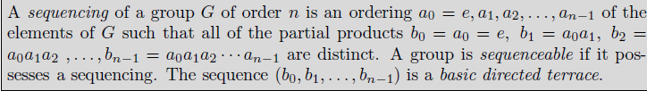
Sequenceable groups
Well studied, but no one seems to have looked at sequencing arbitrary subsets of groups.
Since the first element is e, the entire group can’t add to 0 since that would be both the first and last partial sum. So there must be an element of order 2. The following covers all abelian groups.
Theorem (B. Gordon, 1961): An abelian group is sequenceable if and only if it has a unique element of order 2.
Many results on nonabelian groups and so called R-sequenceability

Slide 61
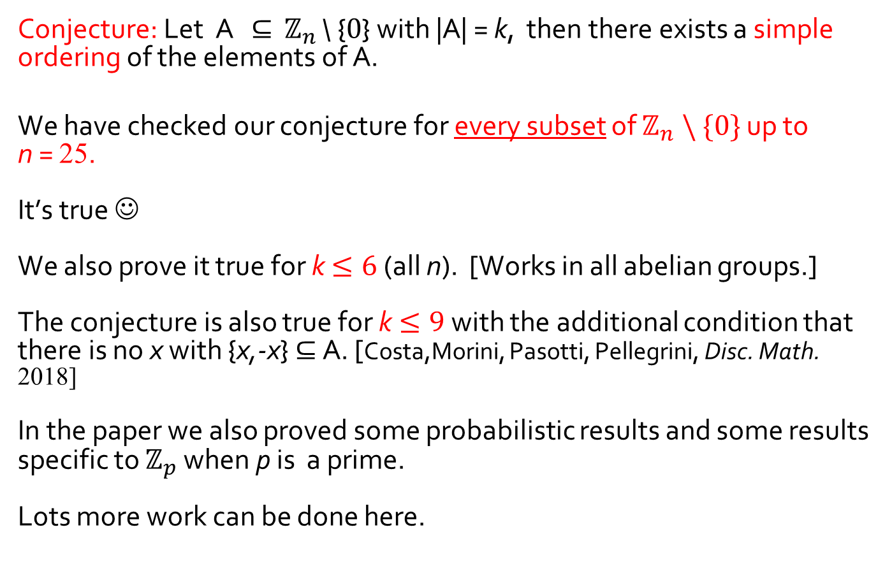
On partial sums in cyclic groups
Archdeacon,Dinitz, Mattern, Stinson (JCMCC, 2016)
Conjecture: Let A $⊆$ $ℤ_{n}$ \ {0} with |A| = k, then there exists a simple ordering of the elements of A.
We have checked our conjecture for every subset of $ℤ_{n} \backslash \{0\}$ up to n = 25.
It’s true ☺
We also prove it true for k$≤6$ (all n). [Works in all abelian groups.]
The conjecture is also true for k$≤9$with the additional condition that there is no x with {x,-x} $⊆$ A. [Costa,Morini, Pasotti, Pellegrini, Disc. Math. 2018]
In the paper we also proved some probabilistic results and some results specific to $ℤ_{p}$ when p is a prime.
Lots more work can be done here.

Slide 62
Back to making Heffter arrays

Slide 63

Results on square integer Heffter arrays with empty cells
(Archdeacon, Donovan, Dinitz, Yazici (Des. Codes Cryptogr. 2015)
Welcome to Australia!
Now let’s put some numbers in boxes ☺
Diane Donovan

Slide 64
Results on square integer Heffter arrays with empty cells
(Archdeacon, Donovan, Dinitz, Yazici (Des. Codes Cryptogr. 2015)
Restricted to the case of square arrays with arithmetic over the integers.
We use H(n;k) to denote an integer n x n Heffter array with k filled cells per row and column. (An H(n,n;k,k) ).
An H(5;4): it is also shiftable ☺
The necessary condition for the existence of an integer H(n;k) is that nk ≡ 0, 3 mod 4.
 | 17 | -8 | -14 | 5
1 |  | 18 | -9 | -10
-6 | 2 |  | 19 | -15
-11 | -12 | 3 |  | 20
16 | -7 | -13 | 4

Slide 65
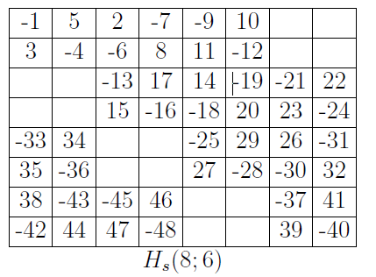
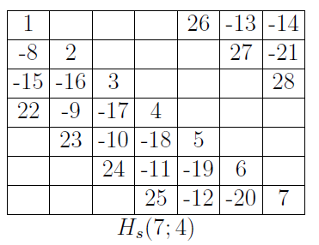
Even number of filled cells per row and column
Again this was the easiest case.
Use 2 x 2 “tiles” and put them
together to get cases with
n and k both even.
Also have a general shiftable H(n;4) construction (n can be odd or even). The diagonal structure of these was very useful.
We solved this case completely

Slide 66
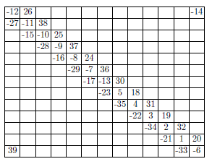
Number of filled cells per row, k ≡ 3 mod 4
Here we realized that integer – current labelings of the Mobius ladder graph and the circular ladder graph given by Youngs in 1970 directly give diagonal Heffter arrays H(n;3).
Example: An integer-current assignment for the Mobius ladder on 13 rungs.
The resulting H(13;3)
Adding shifted copies of the
diagonal H(n;4) completes this
case.

Slide 67
Number of filled cells per row, k ≡ 1 mod 4
We had several methods for this case, and got “most” of the instances.
However we could not solve it completely.
The next slide summarizes our results.

Slide 68
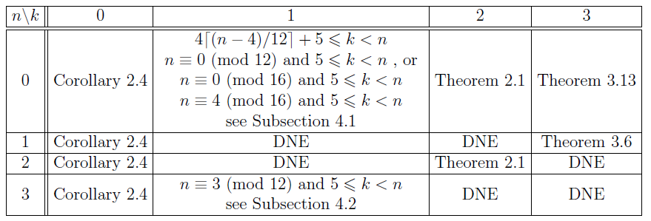
Summary of results on square integer Heffter arrays H(n;k) with empty cells
The table shows our results.

Slide 69



Further Results on square integer
Heffter arrays with empty cells
Dinitz and Wanless, (Ars. Math. Contemp 2017)
I sure do like to ski!!
Now lets put some numbers in boxes☺
Ian Wanless

Slide 70
Summary of results on square integer Heffter arrays H(n;k) with empty cells
The table shows our results.

Slide 71
Summary of results on square integer Heffter arrays H(n;k) with empty cells
The table shows our results.
The two missing congruence classes both have k ≡ 1 (mod 4)

Slide 72
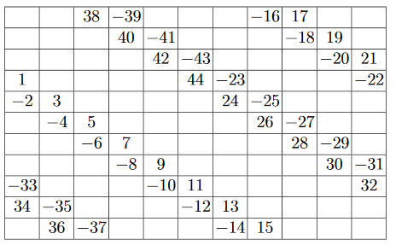
A more flexible way to fill diagonals
Theorem: For every n ≥ 4 and any two pairs of consecutive diagonals, there exists a shiftable integer Heffter array H(n;4) with filled cells contained in the four diagonal cells.
Proof (by construction): An H(11;4) using two sets of consecutive diagonals.

Slide 73
Armed with this construction, we basically only need find a solution with k = 5, and then add 4 filled cells per row and column to get an integer H(n;k), for all n ≡ 0,3 (mod 4) and all k ≡ 1 (mod 4) with 5 ≤ k < n.
We began with roughly the construction of the Heffter arrays coming from ladder graphs and we added two more diagonals.

Slide 74
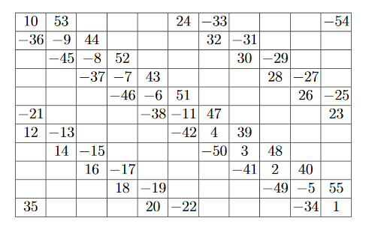
Found one!! An integer H(11;5)
This kind of shows the type of pattern
that we found and will generalize.

Slide 75
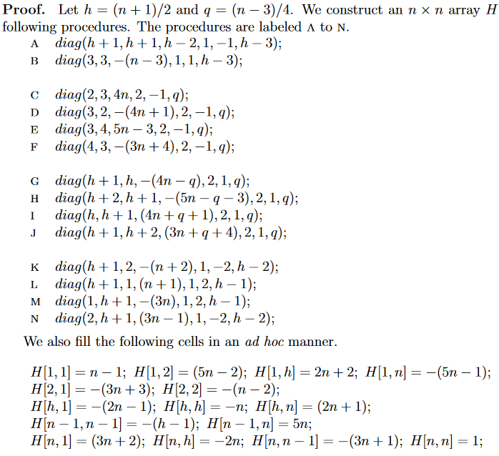
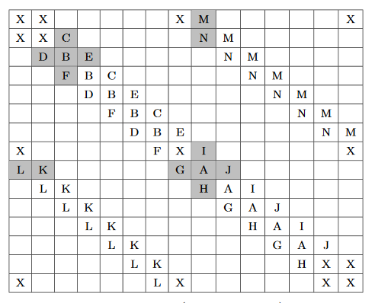

The general construction for k = 5 and n ≡ 3 (mod 4)
(found by computer search)
n = 15 in this schematic

Slide 76
The general construction for k = 5 and n ≡ 3 (mod 4)
(found by computer search)
n = 15 in this schematic

Slide 77
The general construction for k = 5 and n ≡ 3 (mod 4)
(found by computer search on an imposed pattern)
n = 15 in this schematic

Slide 78
The general construction for k = 5 and n ≡ 3 (mod 4)
(found by computer search)
Note this only uses 5 diagonals so we can fill in the empty ones to get the entire congruence class.

Slide 79
Also found the other missing congruence class
So we now have a complete characterization of the existence of square integer Heffter arrays.
Theorem. There exists a square integer Heffter array H(n;k) if and only if 3 ≤ k ≤ n and nk ≡ 0, 3 (mod 4)

Slide 80
Some recent progress on square non-integer Hefter arrays
Nick Cavenagh, Diane Donovan, Sule Yacizi, J.D.
A square non-integer Heffter array can exist if
n ≡ 1 (mod 4) and k ≡ 1 or 2 (mod 4)
n ≡ 2 (mod 4) and k ≡ 1 or 3 (mod 4)
n ≡ 3 (mod 4) and k ≡ 2 or 3 (mod 4)

Slide 81
Some recent progress on square non-integer Hefter arrays
We have the following:
n ≡ 1 (mod 4) and k ≡ 1 or 2 (mod 4)
k = 5 and k = 6
n ≡ 2 (mod 4) and k ≡ 1 or 3 (mod 4)
k = 3
n ≡ 3 (mod 4) and k ≡ 2 or 3 (mod 4)
k = 6 and k = 3

Slide 82
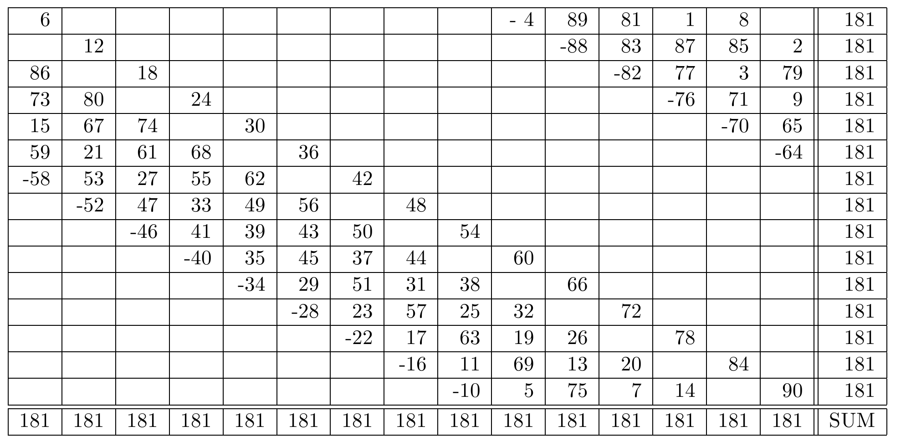
n ≡ 3 (mod 4) and k ≡ 6
Here is an H(15;6) using exactly 6 diagonals:
This pattern generalizes to construct H(n;6) for all n ≡ 3 (mod 4).
Filling the diagonals 4 at a time completes the construction of a H(n;k), for all n ≡ 3 (mod 4) and k ≡ 2 (mod 4).

Slide 83
n ≡ 3 (mod 4) and k ≡ 6
Here is an H(15;6) using exactly 6 diagonals:
This pattern generalizes to construct H(n;6) for all n ≡ 3 (mod 4).
Filling the diagonals 4 at a time completes the construction of a H(n;k), for all n ≡ 3 (mod 4) and k ≡ 2 (mod 4).

Slide 84
Unfortunately -- here since these are not integer Heffter arrays, there will be some rows and columns that will add to 2nk + 1.
Adding 4 extra symbols to each row and column will require that these rows and columns now add to 2n(k+4) + 1, so adding those diagonals which sum to 0 will not work here.
Bummer!!!

Slide 85
n ≡ 3 (mod 4) and k ≡ 3, an H(4n+3;3)
This was more difficult.
Begin with an integer Heffter H(4n;3) coming from the ladder graph construction.
Truncate this to a (4n-7) x (4n-7) array by deleting the last 7 rows and columns (and changing about 3 cells).
Now we will want to complete this to a H(4n+3;3), so we need to add 10 more rows and columns, each with 3 cells each and using the 30 symbols 1,2,3,4,5,6,7,2n,6n - 2,…,6n + 2, 6n+4,10n-3,..., 10n+3, 12n+1,12n+2,… ,12n+9.
Finally, we arrange these 30 symbols into a 10 x 10 array where each row and column has exactly 3 symbols and each row and column adds to either 0 or 2 x 3 x (4n+3) +1=24n+19.
This constructs a H(4n+3;3).
The following is an example of this construction.

Slide 86
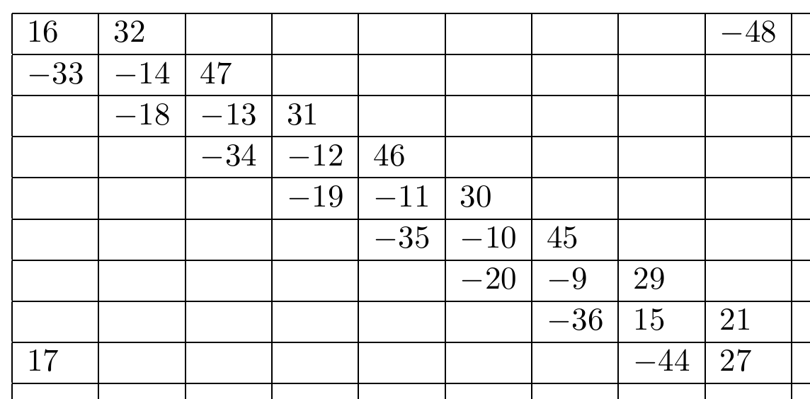
n ≡ 3 (mod 4) and k ≡ 3 (mod 4)
Example: An H(19;3) from an H(16,3)
Start with the H(16;3) and truncate 7 rows and columns to get this 9 x 9 array.

Slide 87
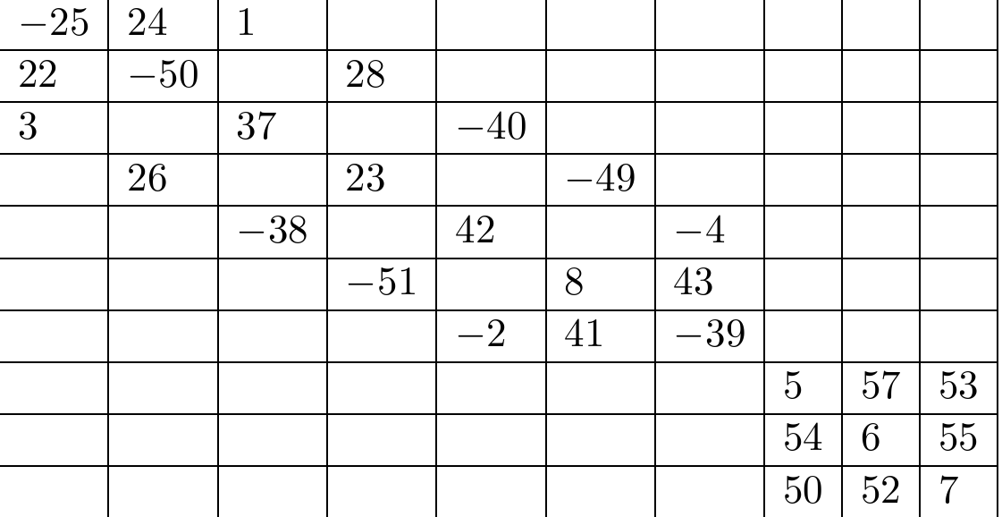
n ≡ 3 (mod 4) and k ≡ 3 (mod 4)
Example: An H(19;3) from an H(16;3) (cont.)
This is the 10 x 10 corner that will be added.

Slide 88
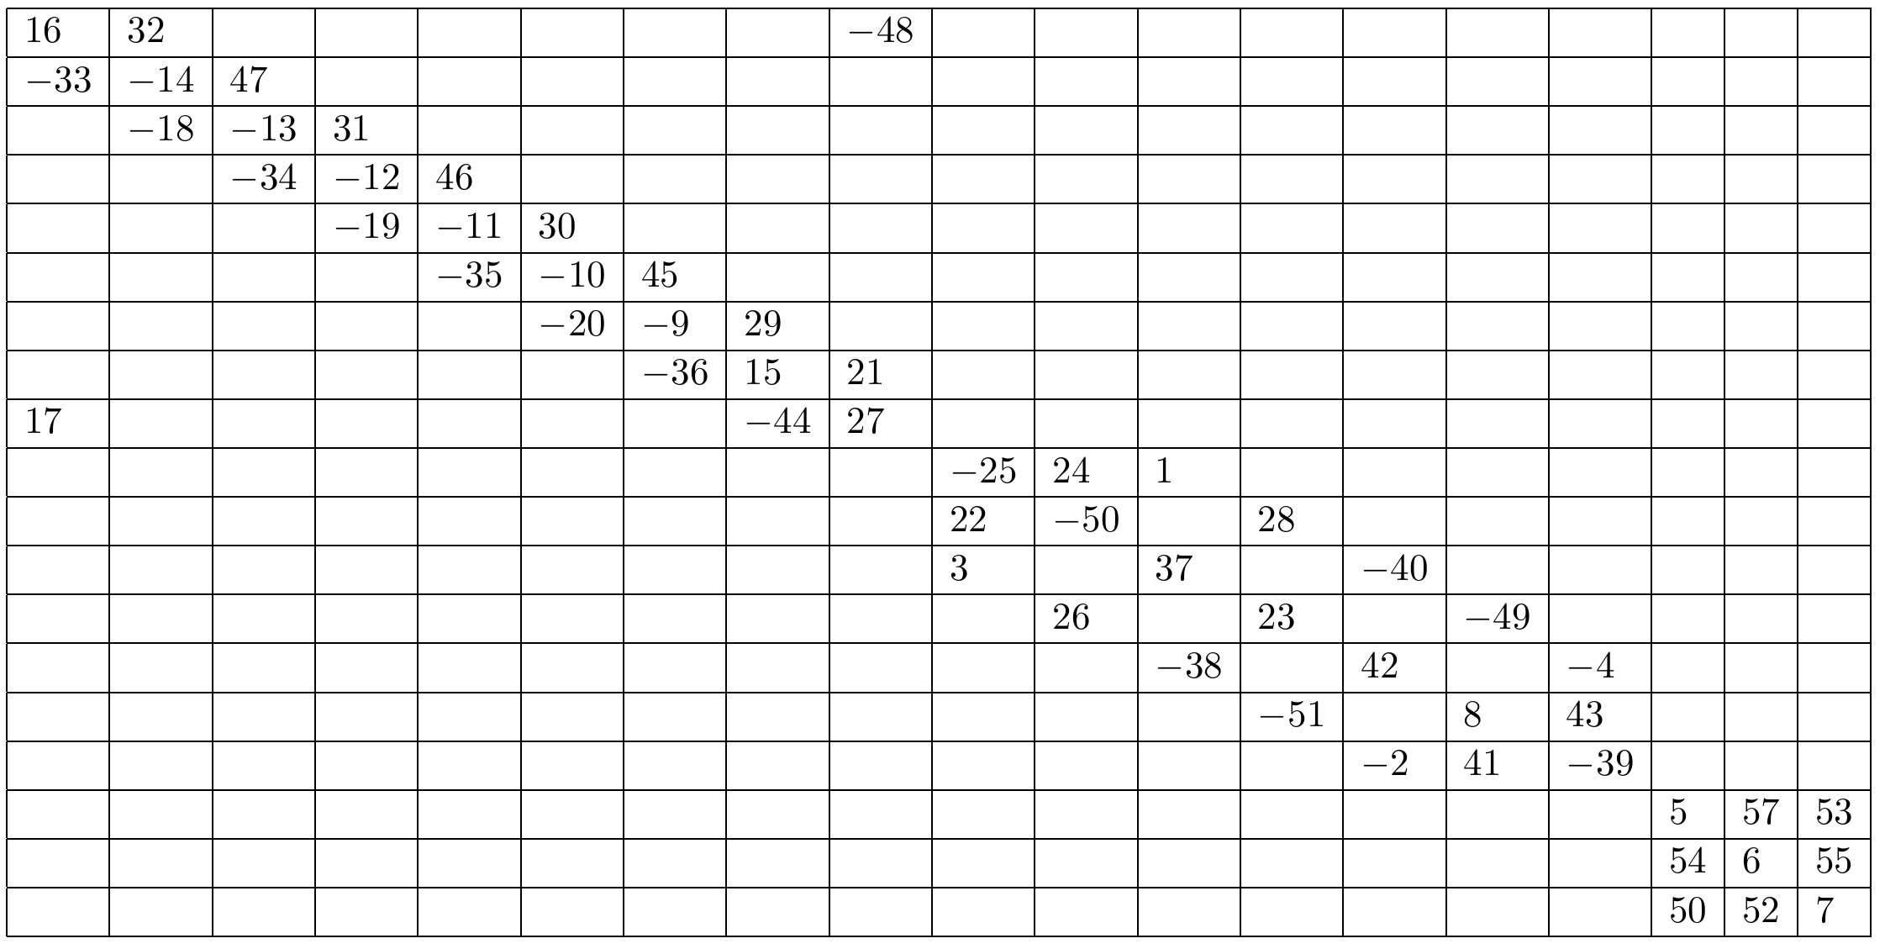
n ≡ 3 (mod 4) and k ≡ 3 (mod 4)
Example: An H(19;3) from an H(16,3)
And this is the final H(19,3).
Note that only 7 of the diagonals are filled so (with some fiddling)
we can get H(n,k) for all n ≡ 3 (mod 4) and k ≡ 3 (mod 4).

Slide 89
Other congruence classes for these square non-integer Heffter arrays have more or less similar constructions.

Slide 90
What about non-square arrays with empty cells
Remember the H(6,12;8,4) below:
No systematic study yet.

Slide 91
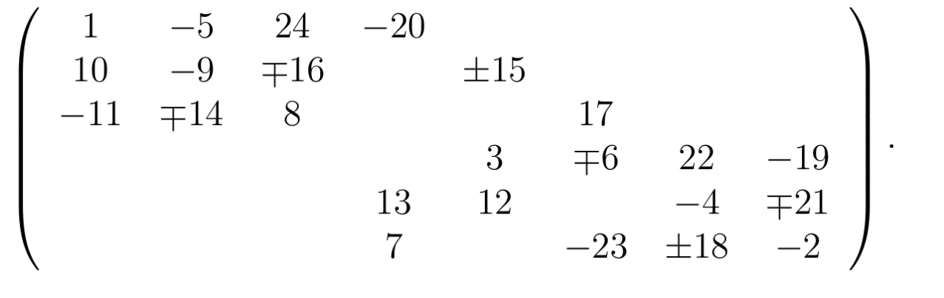
Other Heffter-type arrays
An Example:
Mod 49
Can be used to biembed the complete graph in nonorientable surfaces.
The array above embeds K₄₉ in a nonorientable surface where each edge bounds a 3-cycle and a 4-cycle.
Use upper sign in row sums, lower sign in column
sums

Slide 92
Bibliography
D.S. Archdeacon, Heffter arrays and biembedding graphs on surfaces, Electron. J. Combin. 22 (2015), #P1.74.
D.S. Archdeacon, T. Boothby, and J.H. Dinitz, Tight Heffter arrays exist for all possible values J. Comb. Des, 25 (2017), 5 – 35.
D.S. Archdeacon, J.H. Dinitz, D. Donovan, and S. Yazici, Square integer Heffter arrays with empty cells, Des. Codes Cryptogr., 77 (2015), 409 – 426
D.S. Archdeacon, J. Dinitz, A. Mattern and D.R. Stinson, On Partial Sums in Cyclic Groups, Journal of Combin. Math. and Comb. Comput., 98 (2016), 327-342.
J.H. Dinitz and A. Mattern, Biembedding Steiner triple systems and n-cycle systems on orientable surfaces, Austral. J. of Comb., 67 (2017), 327 -344.
J.H. Dinitz and I.M. Wanless, The Existence of Square Integer Heffter Arrays, Ars. Math. Contemp. 13 (2017), 81 - 93.

Slide 93
Thanks!!

Slide 94
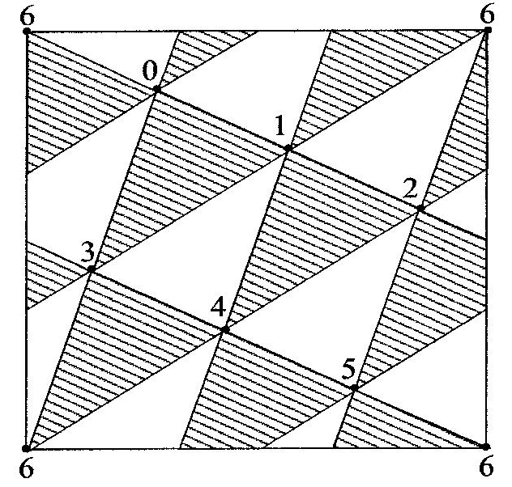
The Uses of Heffter Arrays
(Archdeacon)
An embedding of the complete graph on v vertices on a surface with each edge on both an m-cycle face and an n-cycle face is termed a biembedding.
In design theoretic terms a biembedding is a simultaneous embedding of an m-cycle system and an n-cycle system
both on v points.
A biembedding of two 3-cycle systems
(Steiner triple systems) on 7 points
on the torus.

Slide 95
Heffter arrays to embeddings
(special case of tight arrays)
Let H= H(m,n) be a tight Heffter array.
For each row r of H, define a permutation on the elements of row r consisting of a single cycle and let ω_{r} denote the union of these permutations.
Let ω_{c} denote the analogous permutation of the column symbols.
Say that ω_{r} and ω_{c} are compatible if the permutation (ω_{r} о ω_{c} ) is a cyclic permutation.

Slide 96
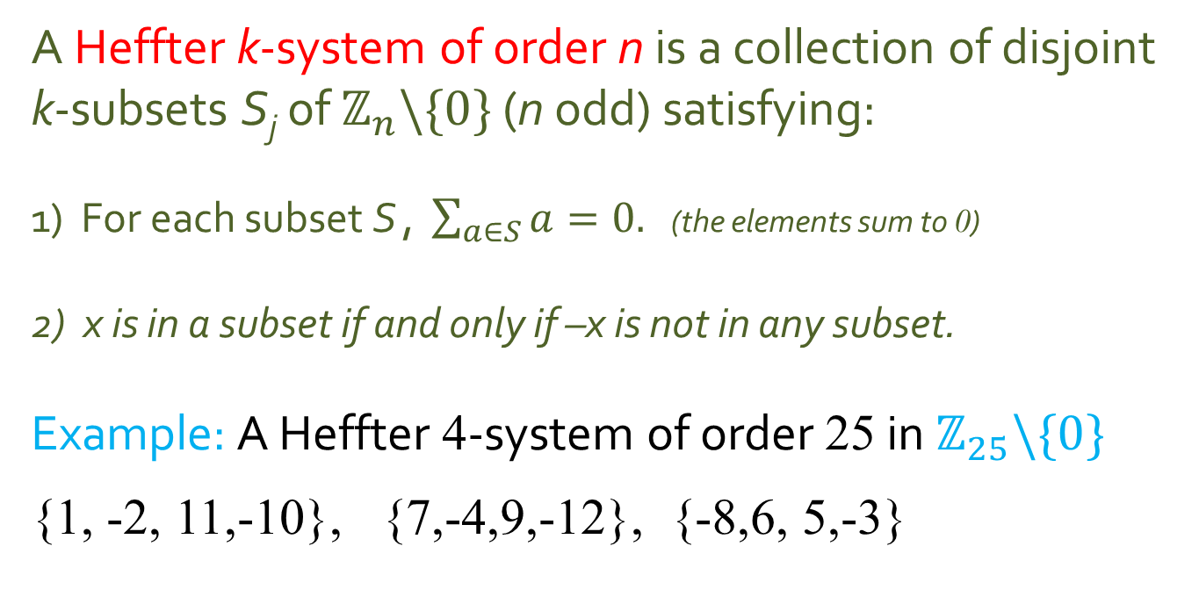
Heffter systems
A Heffter k-system of order n is a collection of disjoint k-subsets S_{j} of $ℤ_{n}\backslash \{0\}$ (n odd) satisfying:
1) For each subset S , $\sum_{a∈S}{a=0.}$ (the elements sum to 0)
2) x is in a subset if and only if –x is not in any subset.
Example: A Heffter 4-system of order 25 in $ℤ_{25}\backslash \{0\}$
{1, -2, 11,-10}, {7,-4,9,-12}, {-8,6, 5,-3}

Slide 97
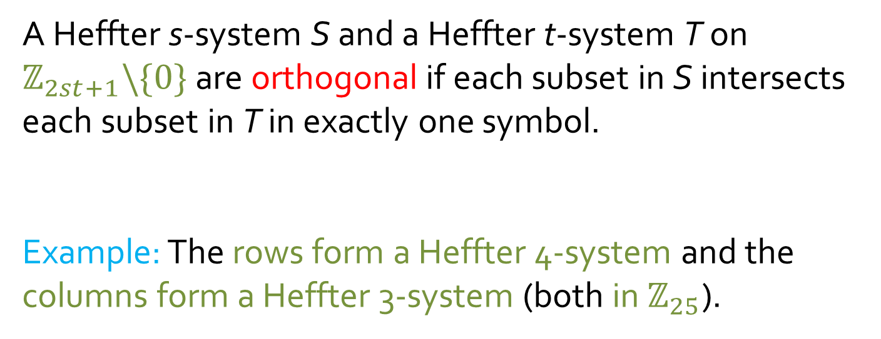
Orthogonal Heffter systems
A Heffter s-system S and a Heffter t-system T on $ℤ_{2st+1}\backslash \{0\}$ are orthogonal if each subset in S intersects each subset in T in exactly one symbol.
Example: The rows form a Heffter 4-system and the columns form a Heffter 3-system (both in $ℤ_{25}$).

Slide 98
Tight Heffter Arrays H(s,t)
A tight Heffter array H(s,t) is an s x t rectangular array with entries a_{i,j} satisfying
{ | a_{i,j} | } = {1,2,…,st}, that is, we use the first st numbers up to sign and
every row and column sum is 0 (termed an integer Heffter array),
or if that is not possible, relax to sums to 0 modulo 2st + 1.
Example: An H(3,4)
The name “Heffter array” comes from a relation to solutions to Heffter’s difference problems that will be explained shortly.
Tight refers to the fact that each cell is filled – we will have other examples where this is not the case.

Slide 99
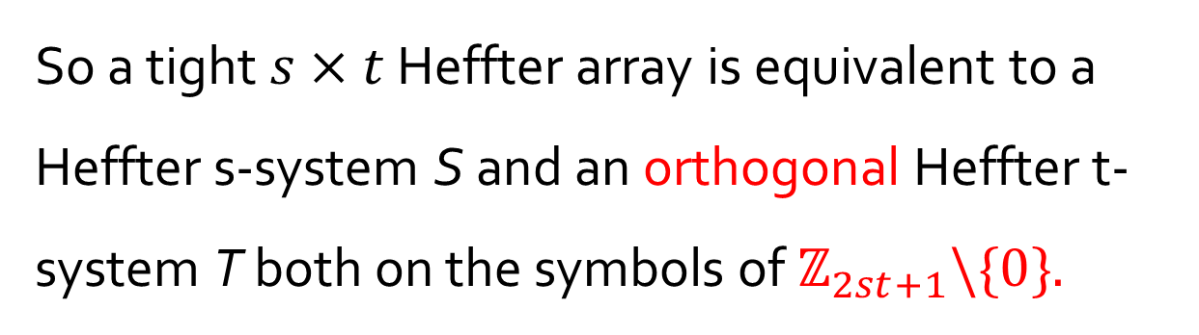
So a tight $s×t$ Heffter array is equivalent to a Heffter s-system S and an orthogonal Heffter t- system T both on the symbols of $ℤ_{2st+1}\backslash \{0\}.$

Slide 100
One final condition (partial sum condition)
For an H(s,t) to give the cycle systems it must also be the case that the partial sums of each row and each column are all distinct (modulo 2st+1).
In this example,
    the partial sums of row 1 are 1,-1,10, 0,
    the partial sums of row 2 are 7,3,12, 0
    the partial sums of row 3 are -8,-2, 3, 0
    The columns are all ok too.
More on this later.

Slide 101
Why have this condition?
It is key that when each row and column is developed modulo 2st+1, that it generates a simple cycle and not a closed walk.
The condition that the sum is zero implies that it is a closed walk, while the partial sum condition guarantees that it is a simple closed walk (a cycle).
Theorem: An H(s,t) (s,t not both even) creates an embedding of K_{2st+1} on an orientable surface provided the rows and columns can all be ordered with all partial sums distinct.

Slide 102
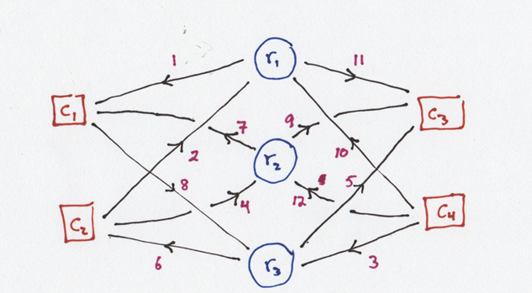
Back to embeddings
Need to show that each vertex is ok. We use current graphs.
Gives the current graph
This can be embedded on a surface with only one face.
Use the ordering of edges from that face to get the ordering of edges around each vertex.

Slide 103
The embedding theorem
Theorem: An H(s,t) (s,t not both even) creates an embedding of K_{2st+1} on an orientable surface with each face either an s-cycle or a t-cycle and each edge bordering exactly one s-cycle and one t-cycle provided the rows and the columns can be ordered with all partial sums distinct.

Slide 104
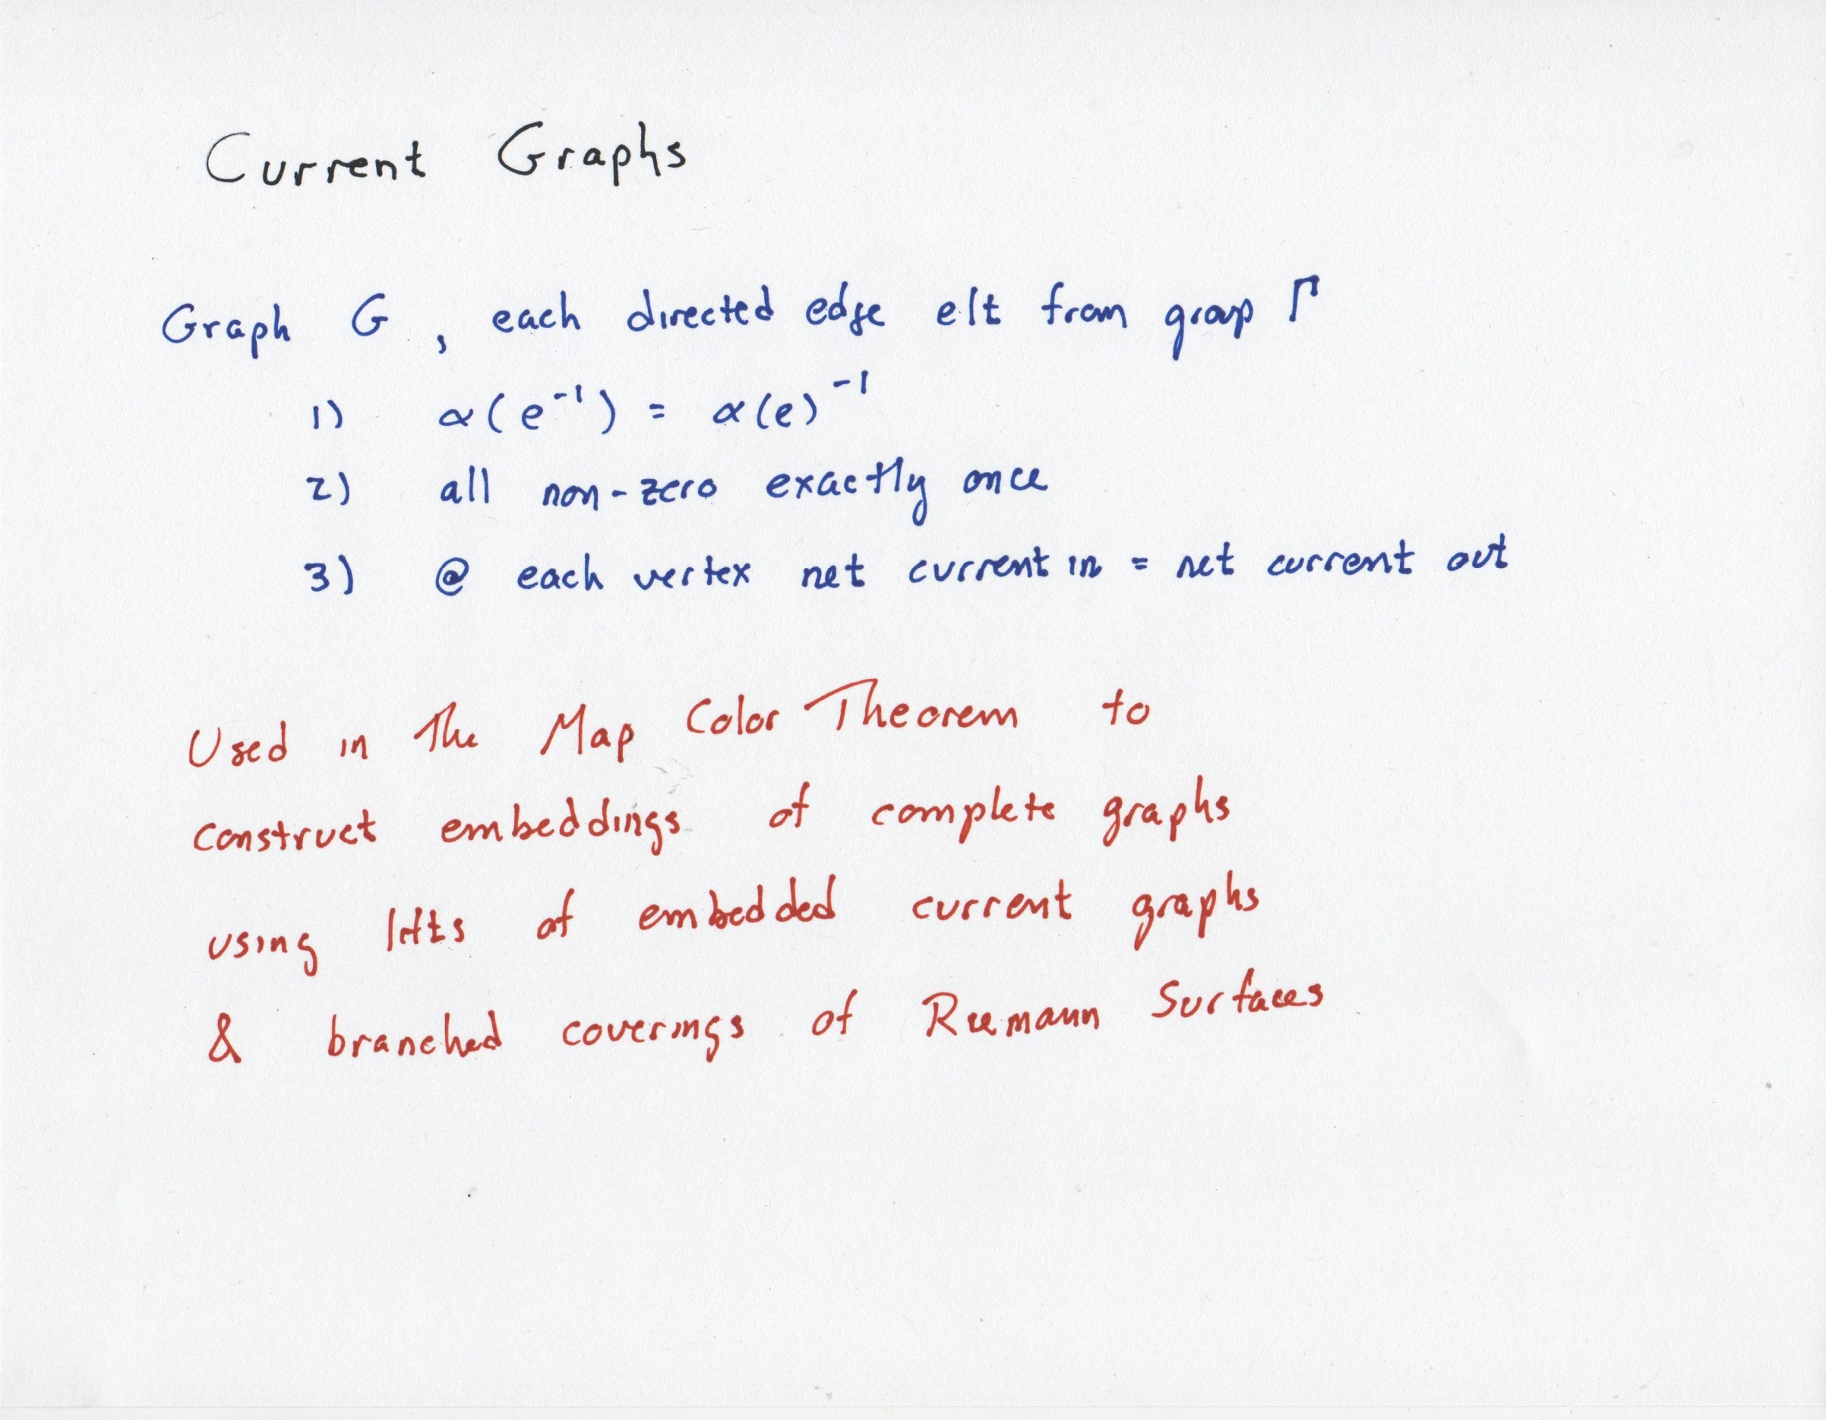

Slide 105
Orthogonal Cycle Systems and Heffter arrays
A non-topological way to use Heffter arrays is to make orthogonal cycle systems. Two cycle systems C₁ and C₂ are orthogonal if any cycle c₁ є C₁ intersects any cycle c₂ є C₂ in at most one edge.
Theorem: If there exists a Heffter array H = H(m,n;s,t) where every row and every column is simple, then there exist an orthogonal s-cycle system and t-cycle system on the same 2ms+1 points. Furthermore – both systems are cyclic.
Proof: Just develop the row and column cycle systems – they will be orthogonal☺
More on this later.
Note similarities to Room squares and orthogonal 1-factorizations.

Slide 106
An example: An H(12,14)
1 | -2 | 3 | -4 | 11 | -9
-7 | 8 | -12 | 10 | -5 | 6
-13 | 14 | -15 | 16 | -23 | 21
19 | -20 | 24 | -22 | 17 | -18
Begin with A =
and B =
To get
a shiftable H(4,6)
1 | -2 | -3 | 4
-5 | 6 | 7 | -8
-9 | 10 | 11 | -12
13 | -14 | -15 | 16
our shiftable H(4,4)
This array has row and column sums equal to 0 and contains the symbols 1 .. 168 (in absolute value).
Hence it is an H(12,14)
6 4 4
4
4
4
A | B ± 72 | B ± 120
A ± 24 | B ± 88 | B ± 136
A ± 48 | B ± 104 | B ± 152

Slide 107
Main theorem connecting tight Heffter arrays to biembeddings
Theorem: Given a simple Heffter array H= H(m,n) with compatible orderings ω_{r} on the rows of H and ω_{c} on the columns of H, there exists an embedding of K_{2mn+1} on an orientable surface such that every edge is on a simple cycle face of size m and a simple cycle face of size n.
Restated in design theoretic terms:
Theorem: Given a simple Heffter array H= H(m,n) with compatible orderings ω_{r} on the rows of H and ω _{c} on the columns of H, there exists a biembedding on an orientable surface of a m-cycle system and an n-cycle system both on v= 2nm+1 points.
Note: the general case is given in Archdeacon’s paper.

Slide 108
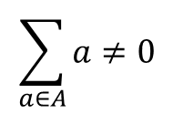
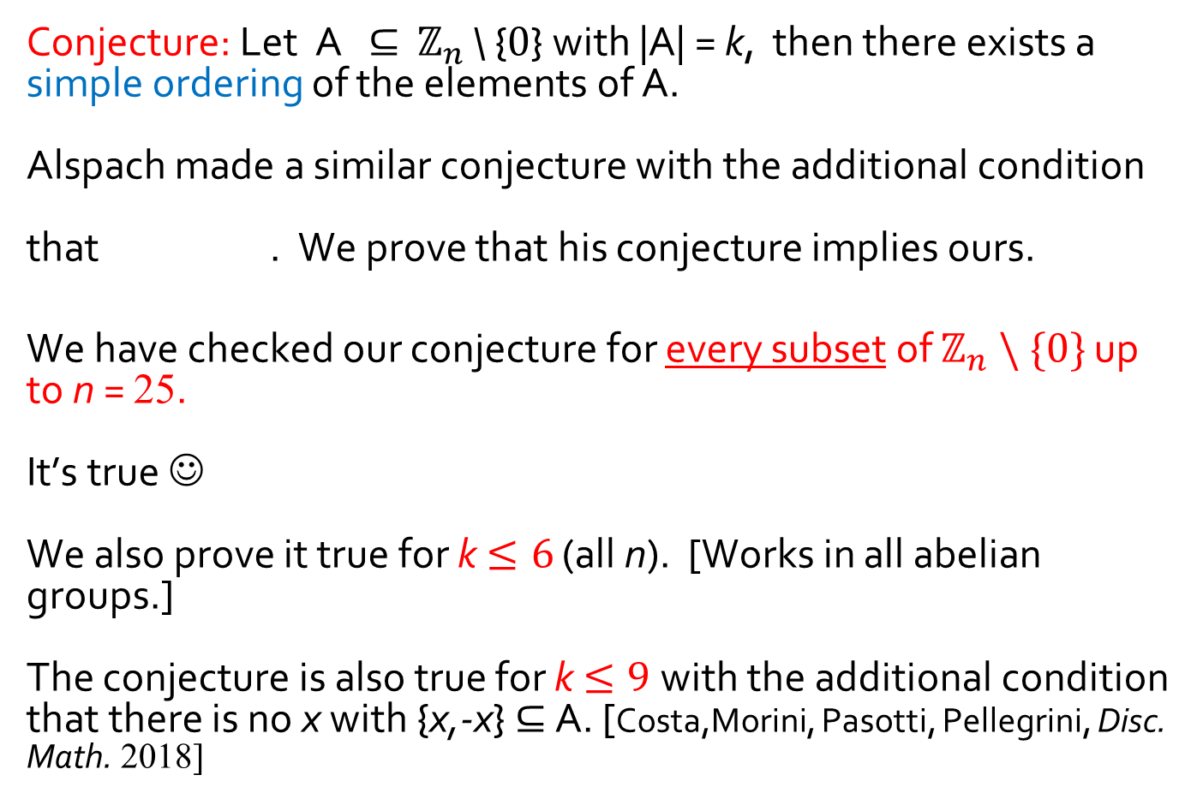
On partial sums in cyclic groups
Archdeacon,Dinitz, Mattern, Stinson (JCMCC, 2016)
Conjecture: Let A $⊆$ $ℤ_{n}$ \ {0} with |A| = k, then there exists a simple ordering of the elements of A.
Alspach made a similar conjecture with the additional condition
that . We prove that his conjecture implies ours.
We have checked our conjecture for every subset of $ℤ_{n} \backslash \{0\}$ up to n = 25.
It’s true ☺
We also prove it true for k$≤6$ (all n). [Works in all abelian groups.]
The conjecture is also true for k$≤9$with the additional condition that there is no x with {x,-x} $⊆$ A. [Costa,Morini, Pasotti, Pellegrini, Disc. Math. 2018]
$$\sum_{a∈A}{a}≠0$$

Slide 109
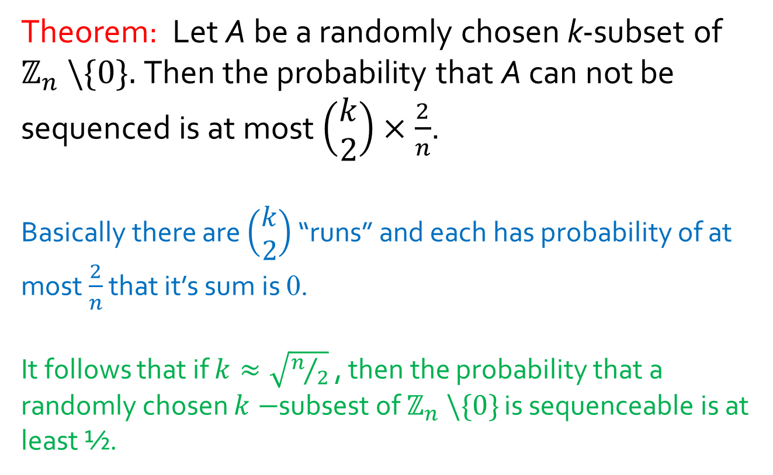
A probabilistic result
Theorem: Let A be a randomly chosen k-subset of $ℤ_{n} \backslash \{0\}.$Then the probability that A can not be sequenced is at most $\left(\begin{matrix}k \\ 2\end{matrix}\right)×\frac{2}{n}$.
Basically there are $\left(\begin{matrix}k \\ 2\end{matrix}\right)$ “runs” and each has probability of at most $\frac{2}{n}$ that it’s sum is 0.
It follows that if $k≈\sqrt{n/2}$ , then the probability that a randomly chosen $k−$subsest of $ℤ_{n} \backslash \{0\}$ is sequenceable is at least ½.

Slide 110
Back to Orthogonal Cycle Systems
Recently, Costa, Morini, Pasotti, and Pellegrini proved the following result about square simple Heffter arrays with small k.
Theorem: If 3 ≤ k ≤ 10, then there exists a square simple integer Heffter array H(n;k) for all n ≥ k with nk ≡ 0, 3 (mod 4).
Translated to orthogonal cycle systems this theorem says:
Theorem: If 3 ≤ k ≤ 10, then there exists a pair of orthogonal cyclic k-cycle decompositions of the complete graph of order
2nk + 1 for all n ≥ k with nk ≡ 0, 3 (mod 4).

